Slide 1

Team 5
Final Project
Group members:
107034032曾博賢
107034045林辰勳
107034055倪子傑

Slide 2

Outline
1. Ideation
2. IPO diagram
3. Use case and sequence diagrams
4. Prototype
5. Future prospect
6. Q&A

Slide 3
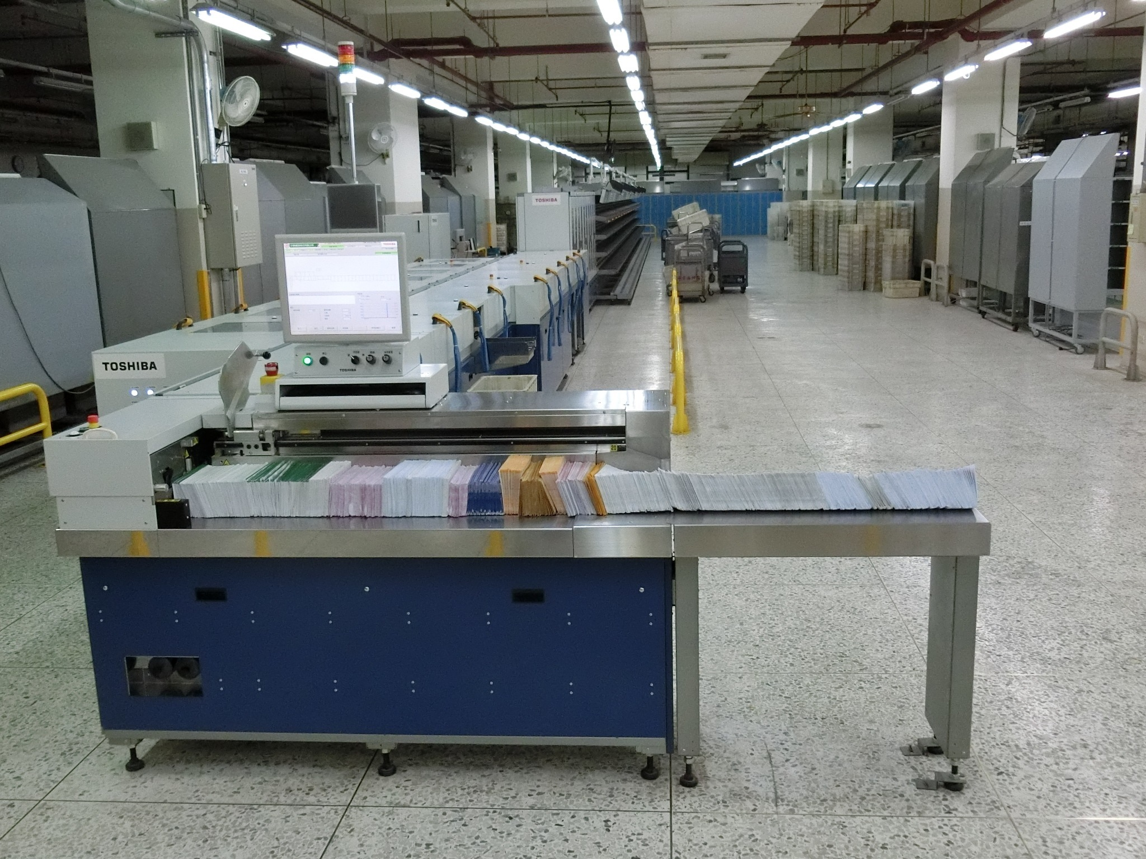
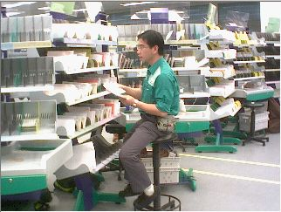
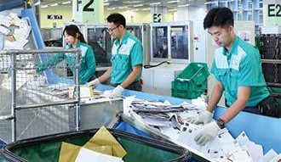
PART 1. Ideation(background)
Our idea came from the presentation of how the post office distribute the letters.
(less than 10 in Taiwan)

Slide 4

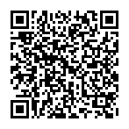



PART 1. Ideation
Our idea is stamp + QR code + programing + scanner
In the end, we don’t need stamps anymore!!!!!!
In addition, it’s easier to distribute the letters.

Slide 5
PART 2. IPO
INPUT
PROCESS
OUTPUT
ADDRESS
CALCULATE MAILING FEE
MAILING FEE
SIZE
SAVE THE DATA
QR CODE
(STAMP)
RECEIVER’S NAME
CONFIRM SOME INFORMATION
RECEIPT
SENDER’S NAME

Slide 6
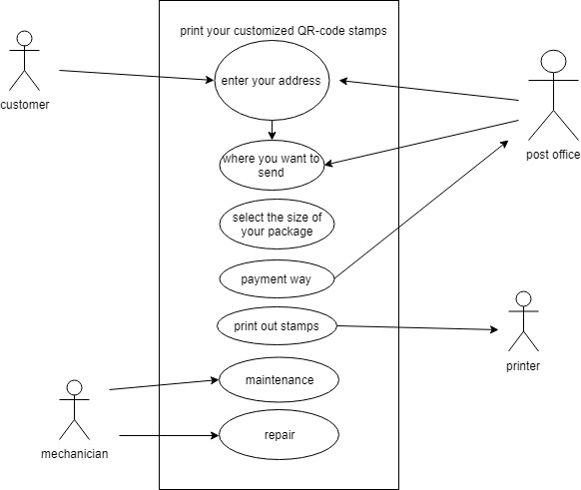
PART 3. Use case & Sequence diagram
Use case-1
Creating your customized stamps.

Slide 7
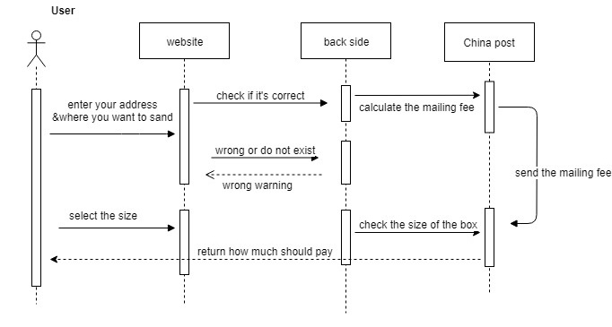
PART 3. Use case & Sequence diagram
Sequence diagram-1
Making you own customized stamp.

Slide 8
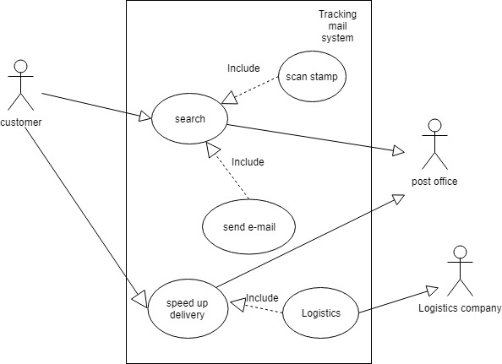
PART 3. Use case & Sequence diagram
Use case-2
Mail tracking function & speedup service

Slide 9
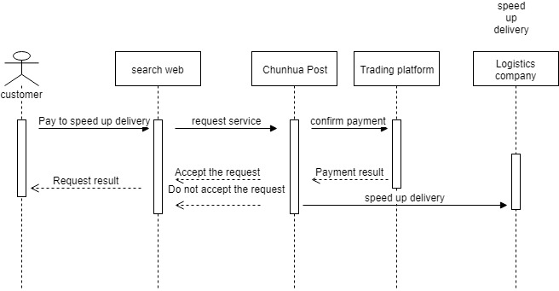
PART 3. Use case & Sequence diagram
Sequence diagram-2
Mail tracking function & speedup service

Slide 10
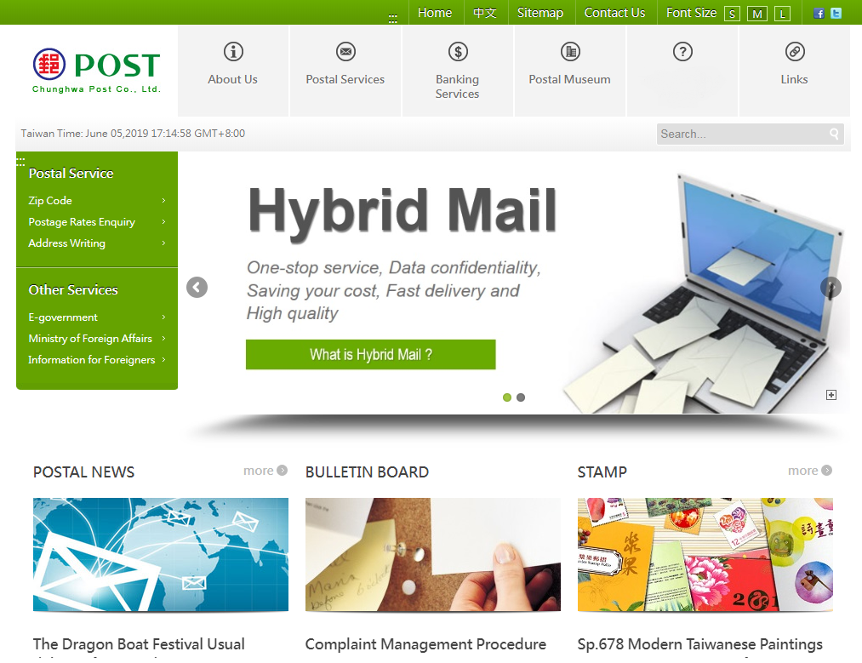
PART 3. Prototype
郵務
Postal service
郵件追蹤
Tracking mail

Slide 11


Chunghwa Post
會員登入(Log In)
帳號(account) :
Nthuieem_awesome*
密碼(password) :
**************
登入
Log in
訪客模式
Visitor mode
忘記密碼?
Forget password?

Slide 12
Chunghwa Post
會員登入(Log In)
帳號(account):
Nthuieem_awesome*
密碼(password):
**************
登入
Log in
訪客模式
Visitor mode
忘記密碼?
Forget password?

Slide 13

請輸入基本資料(type in personal information):
Kevin Lee
姓名 name : _____________
性別 gender :
□男 boy
□女girl
□其他 other
新竹市東區清華大學(NTHU)
住址 address: _____________________________
0988123123
電話號碼 phone number: ______________
確認
confirm

Slide 14
Step1. 選擇信件種類 ( mail’s type)
□ 普通郵件
regular mail
□ 限時郵件
prompt mail
□ 掛號郵件
registered mail
□ 國際郵件
international mail
Step2. 輸入收件人姓名 (receiver’s name)
Andy Lin
收件人姓名( name) : _____________
性別(gender):
□男 male
□女 female
□其他 other
Step3. 輸入收件人地址 (receiver’s address)
縣市( city)
鄉鎮區 (area)
路(road)
號碼(number)
ˇ
ˇ
Daxue
ˇ
ˇ
Tainan
east
1
下一頁
Next page

Slide 15

Step4.選擇包裹大小(若寄信可略過)
choose the package size (letter can ignore)
□ under 60
□ 60~90
□ 90~120
□ 120-150
包裹三邊和 (sum of three sides) | $ 價錢 (price)
60 cm 以下 | 70
60-90 cm | 90
90-120 cm | 110
120-150 cm | 135
下一頁
Next page

Slide 16

請確認以下資料無誤
(Please check the information below)
Kevin Lee
寄件人姓名 Sender’s name : ________________
新竹市東區清華大學(NTHU)
寄件人住址 Sender’s address: _____________________________
Andy Lin
收件人姓名 Receiver’s name : _____________
台南市東區成功大學(NCKU)
收件人住址 Receiver’s address: _____________________________
普通郵件(regular mail)
信件種類 mail type: __________________
70
包裹價錢 Package’s prize: ______
12
郵資 Mailing fee: ______
確認
Confirm
返回
Return
107060500045
流水號 Serial number : ______________

Slide 17

總共需付金額 ( total price)
82
是否確認付款
(Whether to confirm the transaction)
________元($NT)
X
選擇付款方式 (choose payment way)
□ 郵局信用卡
credict card
□ 便利商店
Convenience store
□銀行
Bank
下一步
Next
確認(Confirm)
取消(Cancel)

Slide 18

已寄送驗證碼至手機
(Already send a verification code to your phone)
請輸入驗證碼完成交易
(Please type the verification code to finish transition)
驗證碼(verification code) :_______________
交易成功
(Transaction Succeed)
0354687
確認(Confirm)
繼續(continue)

Slide 19
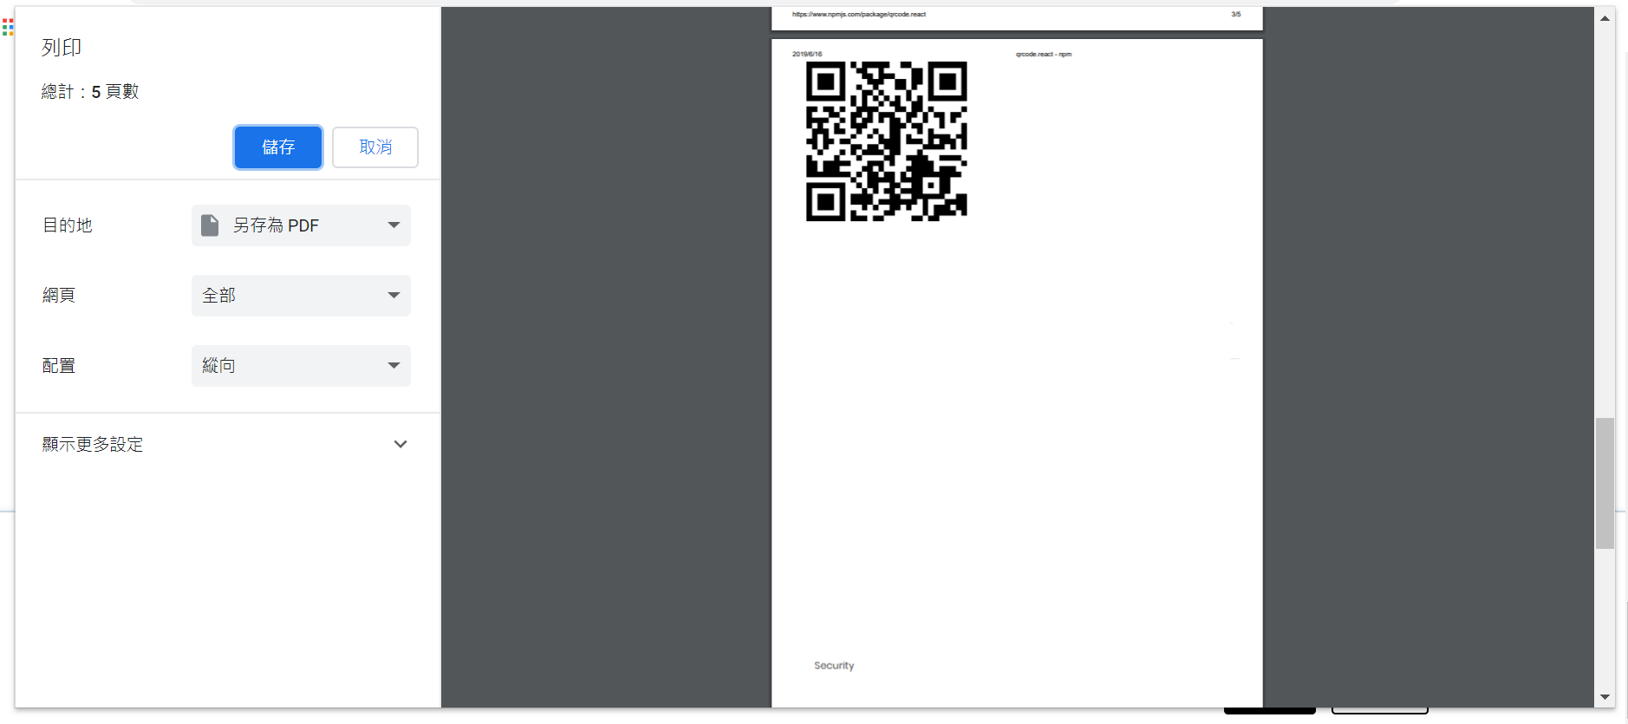
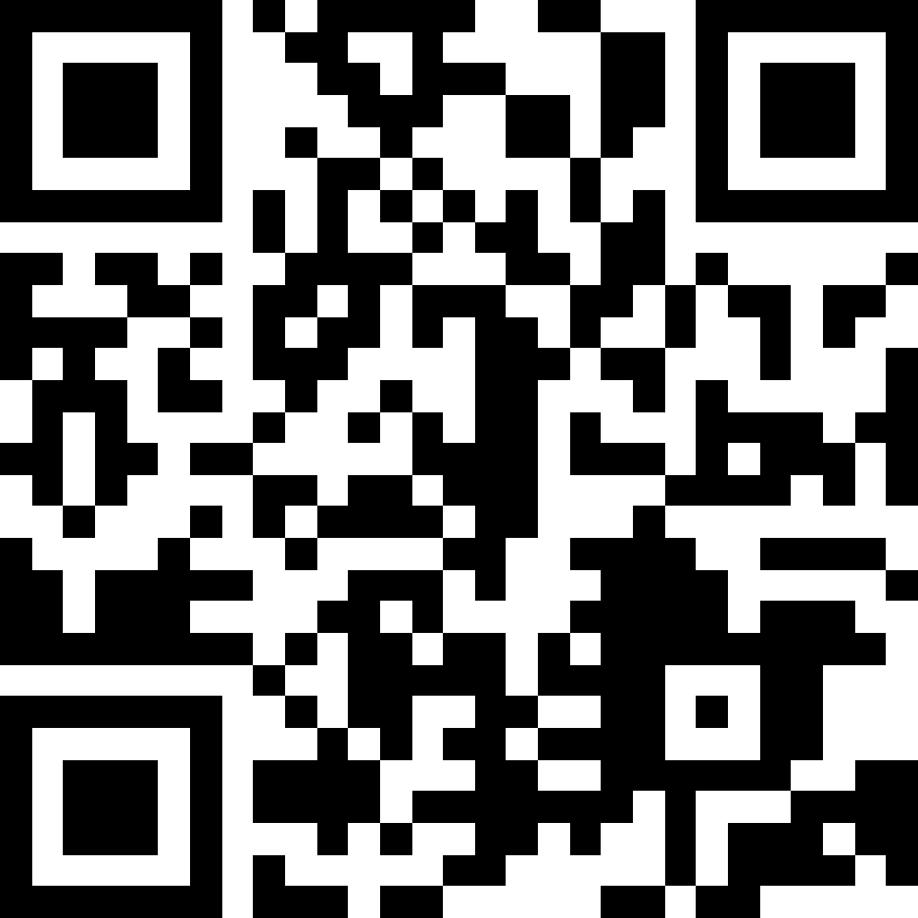

列印您的郵票 (Print your customized stamps)
列印 Print

Slide 20
選擇追蹤方式
輸入流水號(By Serial Number)
107060500001
查詢(Search)
流水號(Serial Number):________________
輸入地址(By Address)
新竹市東區清華大學(NTHU)
寄件者地址(ender's address):______________________
台南市東區成功大學(NCKU)
收件者地址(Sender's address):______________________
查詢(Search)

Slide 21
搜尋結果(Search Result)
流水號(Serial Number):107060500001
寄件者(Sender): Andy Lin
寄件者地址(Sender's address): 新竹市東區清華大學(NTHU)
收件者(Receiver): Peter Lin
收件者地址(Receiver‘s address): 台南市東區成功大學(NCKU)
寄件種類(Shipping type) : 平信(Ordinary Mail)
寄件狀況(Situation):新竹郵局(Hsinchu Post Office)
加速寄件(Speed Up Deliver)
返回(Back)

Slide 22

帳號(ID): Nthuieem_awesome
編號(index)
收件者地址(Receiver‘s address)
流水號(Serial Number)
No.1
台南市東區成功大學(NCKU)
107060500001
查詢(Search)
No.2
台南市東區成功大學(NCKU)
xxxxxxxxxxxxx
查詢(Search)
No.3
台南市東區成功大學(NCKU)
xxxxxxxxxxxxx
查詢(Search)
返回(Back)

Slide 23

加速寄件(Speed Up Deliver)
流水號(Serial Number):107060500001
是否確認付款
(Whether to confirm the transaction)
X
價錢(Price): 10元(NT$)
付款方式(Payment Method)
□信用卡(Credit Card)
□超商(Convenience Store)
□銀行(Bank)
確認(Confirm)
確認(Confirm)
取消(Cancel)

Slide 24
以寄送驗證碼至手機
(Already send a verification code to your phone)
請輸入驗證碼完成交易
(Please type the verification code to finish transition)
驗證碼:_______________
交易成功
(Transaction Succeed)
12345678
繼續(continue)
確認(Confirm)

Slide 25


PART 5. Future Prospect
For the international mail
Now : sender’s name
sender’s address
region (continents and countries)
Future : maybe the receiver’s name
receiver’s address
just like the domestic mail

Slide 26

PART 6. Q&A

Slide 27


Thank you for listening!!

